Slide 1

Notes:
Hello everyone, thank you for joining us. I’m Katie Keith, Vice President of Partnerships at CityHealth, the organization hosting today’s webinar with Dr. Bridger.

Slide 2
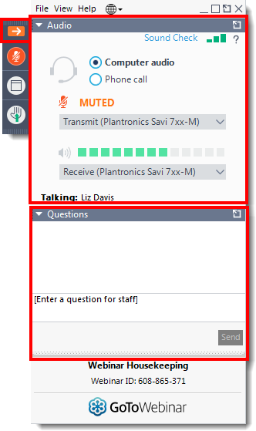
HOW TO ASK A QUESTION
Open and close your control panel
Join audio:
Choose Mic & Speakers to use VoIP
Choose Telephone and dial in using the number in your confirmation email.
There are two ways to ask questions:
Type a question in the question box
Raise your hand to ask a question on the phone
You can type a question or raise your hand at anytime during the presentation but we we will hold all questions until the end.
Notes:
It’s easy to ask a question:
1) Open your control panel
2) Join audio:
Choose Mic & Speakers to use VoIP
Choose Telephone and dial in using the number in your confirmation email.
3) There are two ways to ask questions:
Type a question in the question box
Raise your hand to ask a question on the phone
4) You can type a question or raise your hand at anytime during the presentation but we we will hold all questions until the end.
5) PLEASE TELL US YOUR NAME AND AFFILIATION BEFORE ASKING YOUR QUESTION.

Slide 3
WHAT IS CITYHEALTH?
An initiative of the de Beaumont Foundation and Kaiser Permanente that aims to help cities thrive through policies that improve people’s day-to-day lives.
A package of nine policy recommendations with significant potential to boost health, well-being, and quality of life by addressing the key social determinants.
Notes:
Shelley:
CityHealth, is an initiative of the de Beaumont Foundation and Kaiser Permanente. We provide leaders with a package of evidence-based policy solutions that will help millions of people live longer, better lives in vibrant, prosperous communities. CityHealth regularly evaluates cities on the number and strength of their policies, and today.
CityHealth was created by the de Beaumont Foundation. We’re very proud that Kaiser Permanente, the nation’s largest integrated health system, joined forces with de Beaumont, to support CityHealth’s work.

Slide 4
CITY HEALTH’S NINE POLICIES
Affordable Housing
Alcohol Sales Control
Complete Streets
Earned Sick Leave
Food Safety/Restaurant
Inspection Rating
Healthy Food Procurement
High-Quality Universal Pre-K
Smoke Free Indoor Air
Tobacco 21
Notes:
Big cities in the U.S. face many pressing issues and are pioneering many innovations in response. The CityHealth package is not intended to be an exhaustive list; instead, we selected nine policies that met our specific criteria of: 1) being largely under city jurisdiction, 2) backed by evidence, and 3) showing a track record of bipartisan support. We also looked for pragmatic ideas that are both ripe for widespread adoption, and have real, tangible effects on people’s health and well-being.
Affordable Housing: CityHealth’s assessment of affordable housing policies looks at cities’ inclusionary zoning policies, which are planning ordinances that require that a certain share of new residences be affordable to those with low to moderate incomes. We analyzed the size of developments covered by the law, what percentage of units must be made affordable, and whether the program is evaluated for effectiveness.
Alcohol Sales Control: Evidence shows this is a public safety measure. Our assessment of alcohol sales control laws includes information about city-specific laws, along with the relevant county- and state-level laws.
Complete Streets: From street lighting to bike lanes to crosswalks, these policies ensure that all residents have safe, convenient ways of getting around and staying active—regardless of their age or ability. Although some cities may have standalone transportation policies that share the ultimate goals of a complete streets program, only succinct and comprehensive programs within a singular area of the law were scored here.
Our assessment of complete streets includes information about city-specific laws, along with the relevant county- and state-level laws.
Earned Sick Leave: Earned sick leave laws require employers to allow people to take paid time off for illnesses or injury for themselves or their family members. The quality of cities’ policies is linked to how many family members and what size employer are covered by the law, as well as the number of hours people can earn.
Food Safety: Policies requiring food establishments to publicly post safety inspection “grades” contribute to empowering consumers, reducing foodborne illness rates, and cutting down on health care costs. For this assessment, voluntary or electronic restaurant rating systems were deemed out of scope. Inspection reports without a score and/or binary pass/fail systems were also deemed beyond the scope. This assessment specifically addresses policies where an inspection report with a score is required to be posted near the entrance of the restaurant.
Healthy Food Procurement: Policies that make sure healthy food options are available on public property aid city residents in making smart decisions that will help them achieve and maintain a healthy weight. A city that has a health procurement policy applicable to all city contracts for food and drinks served at city venues, meetings, and events earned a gold medal. Otherwise, cities earned silver or bronze medals based on their healthy vending machine policies.
Pre-K: CityHealth’s assessment of Pre-K quality is based on the National Institute of Early Education Research’s 10 research-based quality standard benchmarks, along with an assessment of the level of enrollment in the city’s largest Pre-K program. These benchmarks are consistent with what research suggests as minimums for highly effective programs.
Smoke-Free Indoor Air: Smoke-free indoor air policies protect non-smokers from the harmful effects of tobacco and reduce smokers’ consumption of tobacco at the same time. Thirty-six out of 40 cities received a medal for smoke-free indoor air laws, including 19 gold, 13 silver, and 4 bronze.
Tobacco 21: Policies that raise the minimum legal age for the sale of tobacco products to 21 can reduce the number of young people – even those younger than 21 – using these products, which greatly reduces their risk for addiction, disease, and premature death. The 2018 assessment also addresses whether the Tobacco 21 law covers e-cigarettes.

Slide 5
HOW DID CITIES PERFORM ON T21?
15 cities received a gold medal

Slide 6
INTRODUCTION: COLLEEN BRIDGER, MPH, PhD
Colleen Bridger, MPH, PhD. was named director of the San Antonio Metropolitan Health District in March 2017.
Prior to joining Metro Health, Dr. Bridger was director of the Stokes County (1997-2002), Gaston County (2002 – 2010) and Orange County (2011 – 2017) Health Departments in North Carolina.

Slide 7

Tobacco 21 in San Antonio
Colleen M. Bridger, MPD, PhD
Director
CityHealth Tobacco 21 Webinar

Slide 8
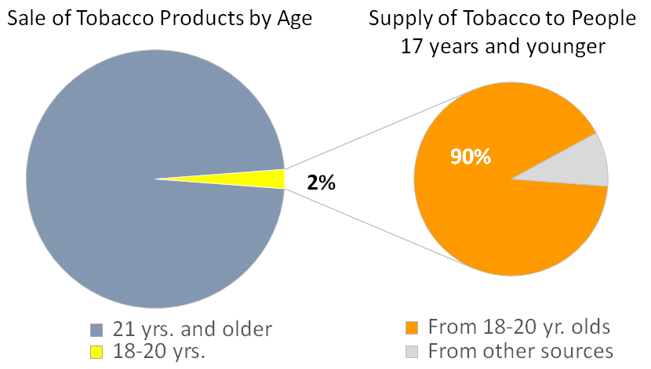
Why Raise the Age?
Nicotine is highly addictive and the adolescent brain is more susceptible to it
95% of adult smokers began smoking before they turned 21
Only 2% of tobacco sold is purchased by 18-20 year olds, but that 2% supplies 90% of the addictive tobacco to younger people

Slide 9
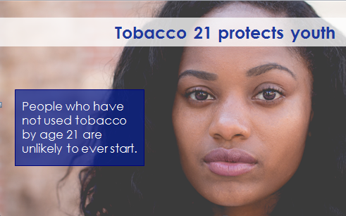
Increasing the Sale Age to 21
A Public Health Policy Solution
Delay age of first tobacco use and reduce risk of becoming regular smoker
Help keep tobacco out of schools
Younger teens have harder time passing themselves off as 21

Slide 10
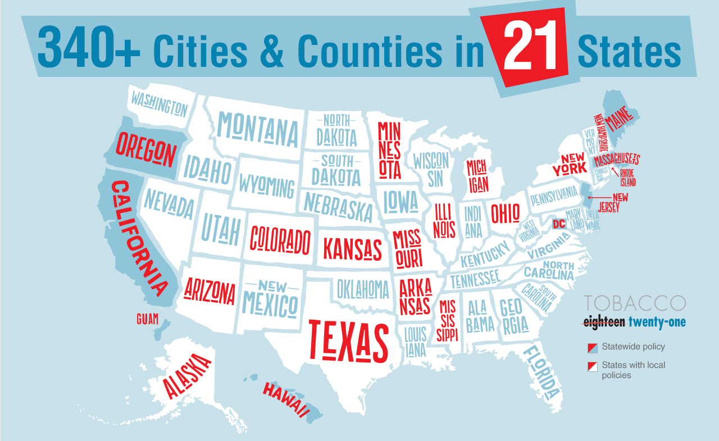
Where is T21 already in place?
30% of Americans covered

Slide 11
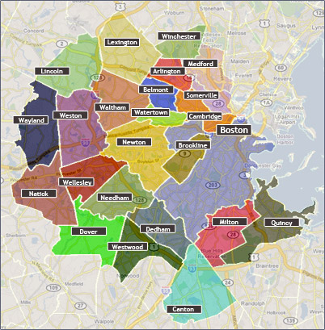
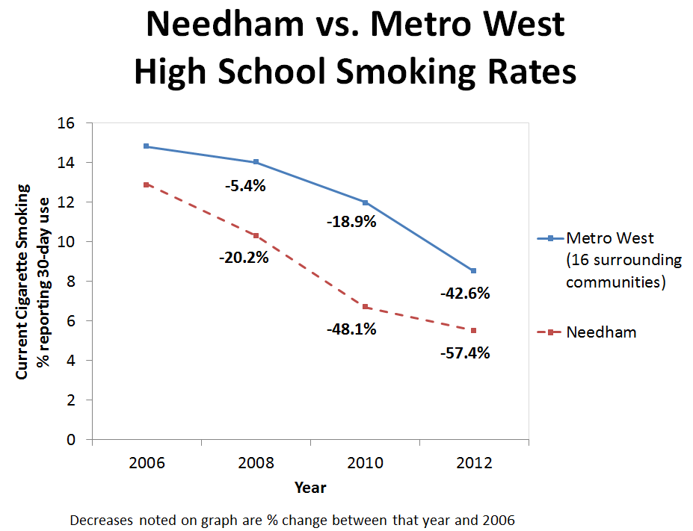
Needham Case History
11

Slide 12
Local Survey Results
5,447 individuals responded to our Tobacco 21 survey that asked the question:
Do you believe that the minimum tobacco sales age should be raised from 18 to 21?
77.5% answered Yes
12

Slide 13


The Coalition

Slide 14

Information & Education on T21

Slide 15
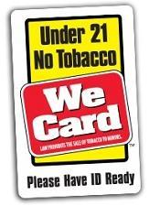
Enforcement
Metro Health will lead enforcement
Will verify signage/training during routine inspections
Unannounced compliance checks
  Random sampling used to determine locations of retailers

Slide 16

Lessons Learned
Work with advocacy community
Open, honest, redundant communication
“The community wants this”
PUP
Be prepared for retail pushback
I believe the science…BUT…

Slide 17

Power of Policy
buzzsaw

Slide 18

For More Information
Visit our website
www.sanantonio.gov/tobacco21
Materials available for download and
Keep checking back - more posted soon

Slide 19

Thank you. Any Questions?
Colleen M. Bridger, MPH, PhD
Director

Slide 20
REMINDER: HOW TO ASK A QUESTION
Open your control panel
Join audio:
Choose Mic & Speakers to use VoIP
Choose Telephone and dial in using the number in your confirmation email.
There are two ways to ask questions:
Type a question in the question box
Raise your hand to ask a question on the phone
Having trouble? Email walker@brassrc.com
You can type a question or raise your hand at anytime during the presentation but we we will hold all questions until the end.
Notes:
Liz:
We will now open up the question and answer session. It’s easy to ask a question:
1) Open your control panel
2) Join audio:
Choose Mic & Speakers to use VoIP
Choose Telephone and dial in using the number in your confirmation email.
3) There are two ways to ask questions:
Type a question in the question box
Raise your hand to ask a question on the phone
4) You can type a question or raise your hand at anytime during the presentation but we we will hold all questions until the end.
5) PLEASE TELL US YOUR NAME AND AFFILIATION BEFORE ASKING YOUR QUESTION.

Slide 21


LET’S CONNECT
Katie Keith, JD, MPH
Vice President of Partnerships, CityHealth
Katie@cityhealth.org, 702-540-6398
Follow us!
@city_health Facebook.com/city_health
Sign up to receive updates at cityhealth.org/join-us
Notes:
We want to keep in touch with city leaders like you. We will be releasing reports, briefs, and holding events about how to bring more evidence based policy making to cities in the coming months. We also hope to see you all at NACCHO Annual this summer.
Follow us on Twitter and Facebook, and visit us at cityhealth.org/join-us to sign up for our newsletter and receive other updates.
We are also looking to partner with your cities to help further these nine policies. If you want to make progress on your medal status before next year, we want to hear from you.
If you have additional questions, or if you would like to know more about partnering with CityHealth, please contact:
Katie Keith, JD, MPH
Vice President of Partnerships, CityHealth
katie@cityhealth.org
702-540-6398

